Slide 1

GreenSense: The Complete IoT Solution for Plant Growth and Care Using Machine Vision and AI-Powered Disease Detection.
B.M.S. College of Engineering
Department of Information Science and Engineering
Project Phase Two Review - I
Presented by:
Sanat K
Shreesha Bhat
Vishal S
Under the guidance of
Dr. Anitha H M
Assistant Professor
Department of ISE

Slide 2
Introduction
In modern homes, plants play a vital role in enhancing aesthetic appeal and creating a calming, natural environment. However, caring for indoor plants can be challenging, especially with busy lifestyles, inconsistent watering schedules, and changing environmental conditions.
Additionally, as water resources become scarce due to pollution and climate change, efficient use of water in plant care has become increasingly important.
Dry soil, insufficient watering, and unpredictable indoor conditions are some of the common issues that hinder the growth of decorative plants, often leading to their premature decline.
These challenges highlight the need for a smarter, more sustainable approach to home plant care.
Objectives-
Sustainable Urban Gardening: Enable urban and terrace gardeners to monitor and care for plants with minimal manual intervention, promoting water conservation and resource efficiency.
AI and Machine Vision for Plant Health: Use machine learning and machine vision to detect plant diseases early and provide actionable care recommendations, ensuring healthier plants and optimized fertilizer use.
Scalable Agricultural Solutions: Develop a modular system that can be scaled for larger agricultural use, empowering small-scale farmers to improve crop yield and productivity through data-driven insights.

Slide 3
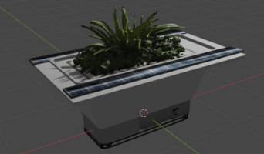
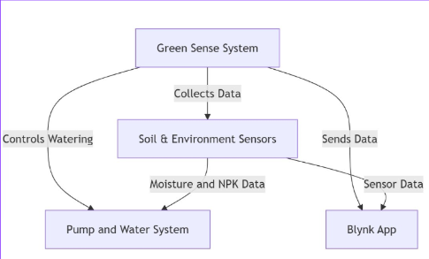
System Design
High level Design –
The GreenSense system is an IoT-enabled smart pot designed for real-time plant monitoring and automation.
It uses sensors to track soil moisture, temperature, light levels, and air quality, while a camera module with machine learning detects plant diseases.
The system automates irrigation, provides fertilizer suggestions, and sends notifications via the Blynk app.
Powered by solar energy, it is affordable, modular, and scalable, making it ideal for urban gardeners and small-scale farmers, with potential applications in large agricultural lands.

Slide 4
Low Level Design -
Sensors Module:
Collects real-time data for humidity, temperature, light, and soil moisture.
Sends data to the microcontroller for processing.
ESP32 Microcontroller:
Acts as the central control unit. Receives data from sensors, processes it, and controls actuators like the pump.
Communicates with the cloud via Wi-Fi.
Disease Detection Module:
Captures images using the camera module.
Processes images locally or sends them to the cloud for CNN-based analysis.

Slide 5
Cloud Services:
Stores and analyzes collected sensor data and images.
Hosts machine learning models for disease detection and yield prediction.
Generates insights and sends notifications to the user.
User Interface:
Provides a mobile application for users to view real-time data, insights, trends, recommendations and alerts.
Power Module:
Includes a solar panel and a 3.7v rechargeable Li-ion battery to power the system.
Communication Module:
Enables multiple ESP32 units to communicate and share data in larger setups using Bluetooth Low Energy and Wi-Fi.

Slide 6
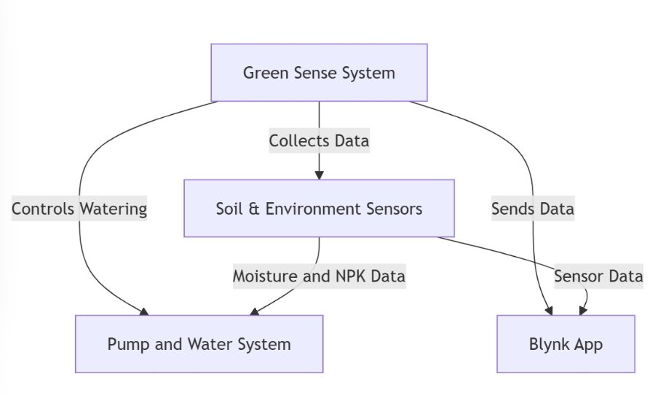
Data Flow Diagrams

Slide 7
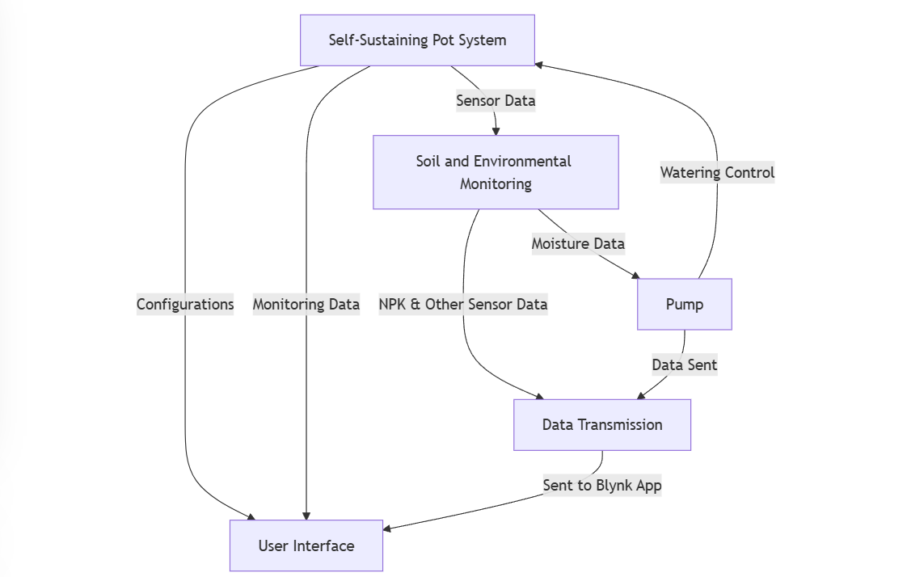
Data Flow Diagrams

Slide 8
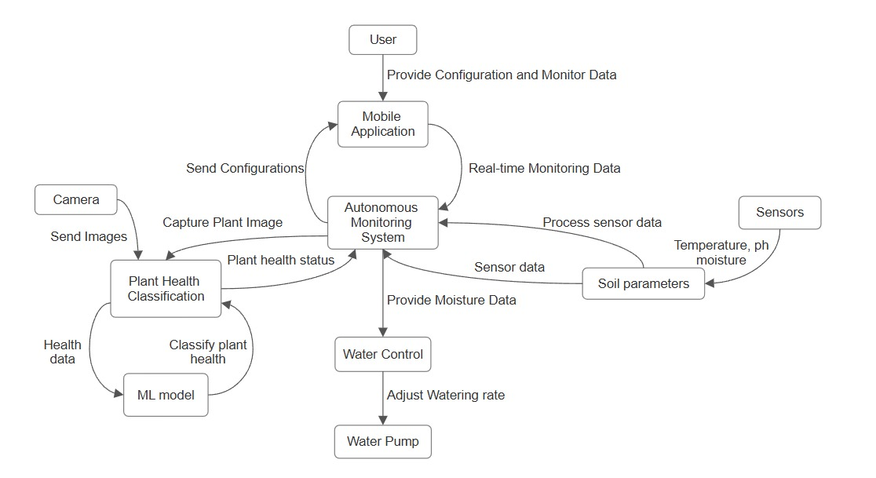
Data Flow Diagrams

Slide 9
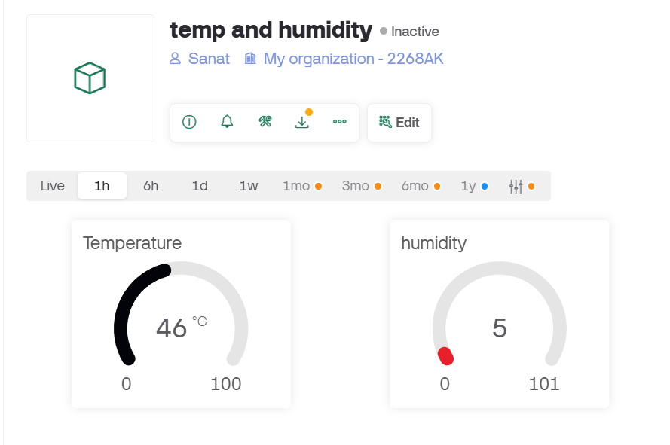
Implementation
Blynk User Interface

Slide 10
Implementation
Technology Stack
Hardware: Arduino Espressif 32 microcontroller for sensor and actuator integration.
Programming Language: Embedded C for efficient firmware development.
Application Development: Blynk platform for mobile app and web-based system monitoring and control.
Machine Learning: Convolutional Neural Network (CNN) for disease detection and plant health analysis.
Cloud Integration: Firebase for real-time data storage and processing, ensuring accessibility and scalability.

Slide 11
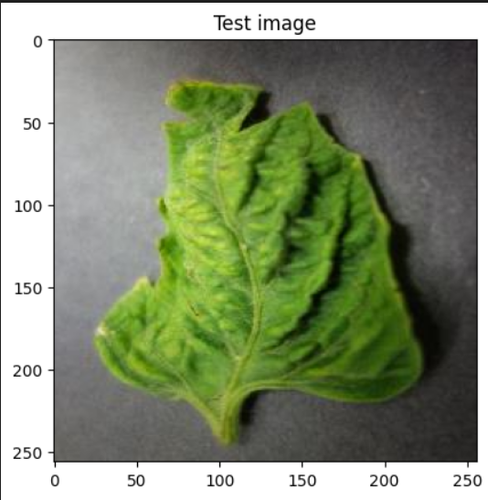
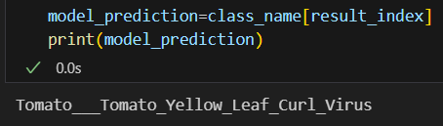
Implementation
Deep Learning Model-
The deep learning model for plant disease detection is built using TensorFlow and employs a Convolutional Neural Network (CNN) architecture.
The model is trained on a dataset of plant images, where it learns to identify patterns and features associated with various plant diseases.
Techniques such as data preprocessing and augmentation are applied to improve the model's performance and generalization.
Once trained, the model can accurately classify plant diseases, providing a reliable solution for early detection and effective plant management.

Slide 12
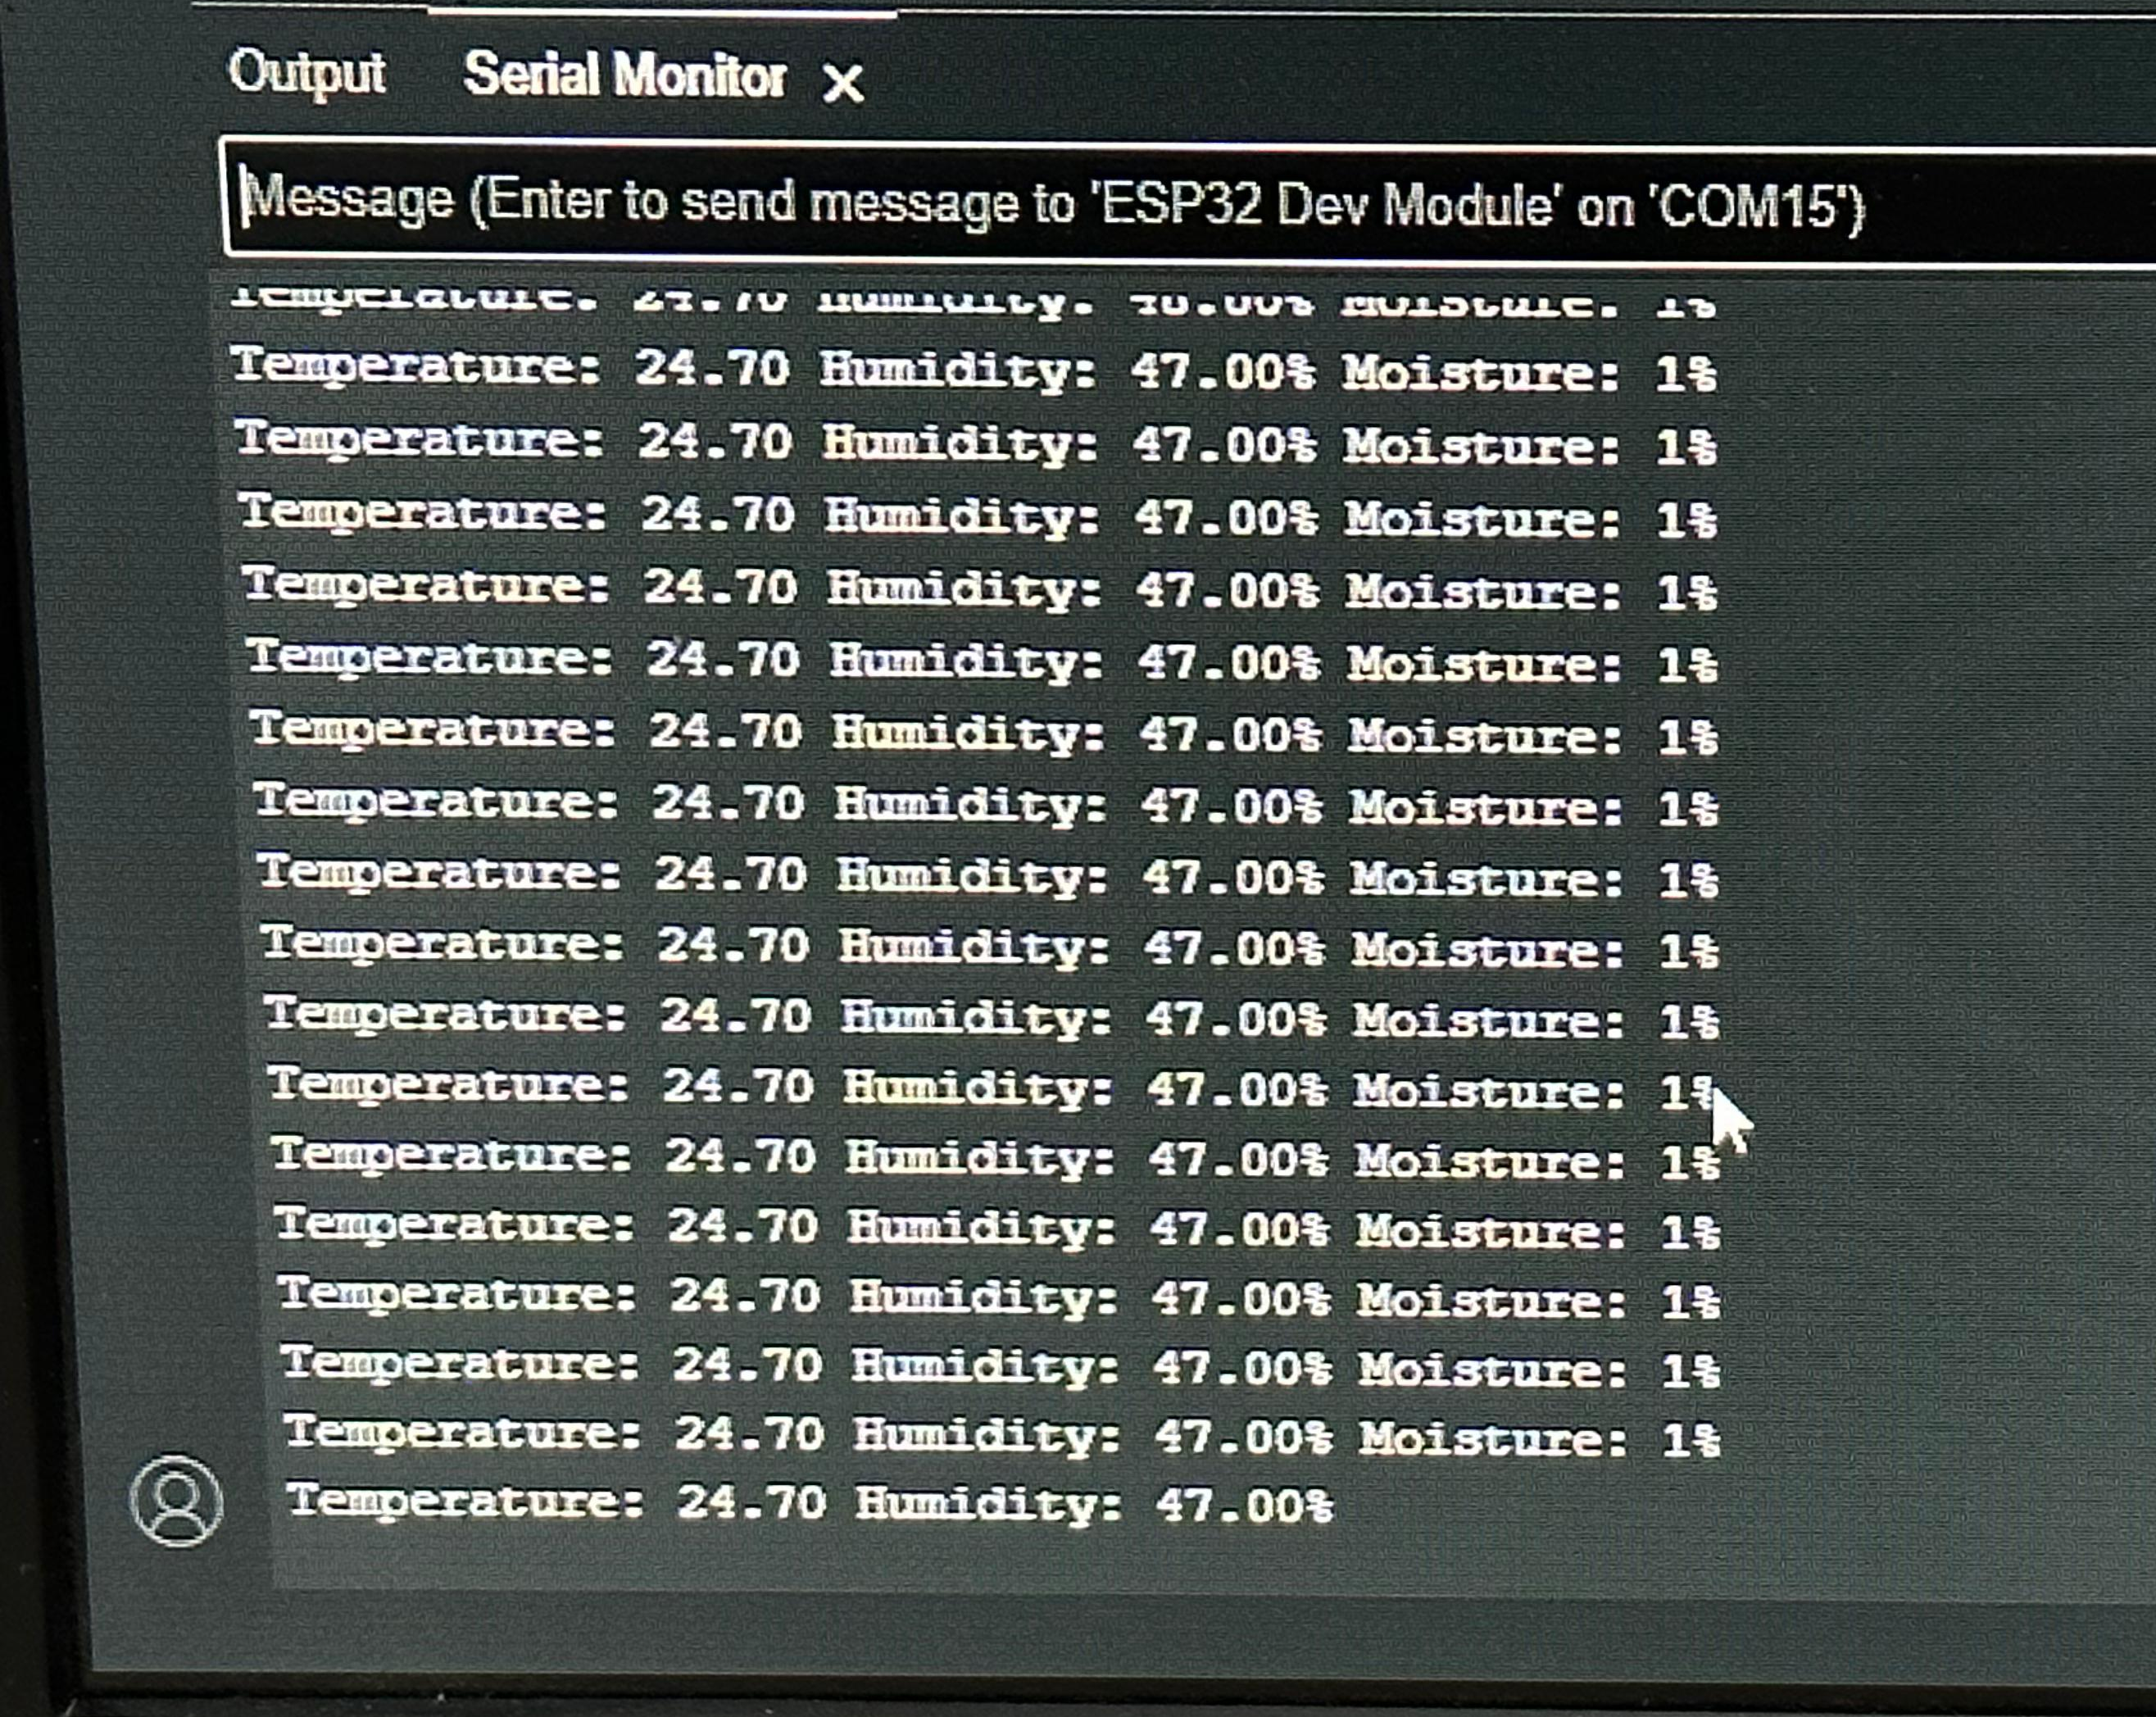
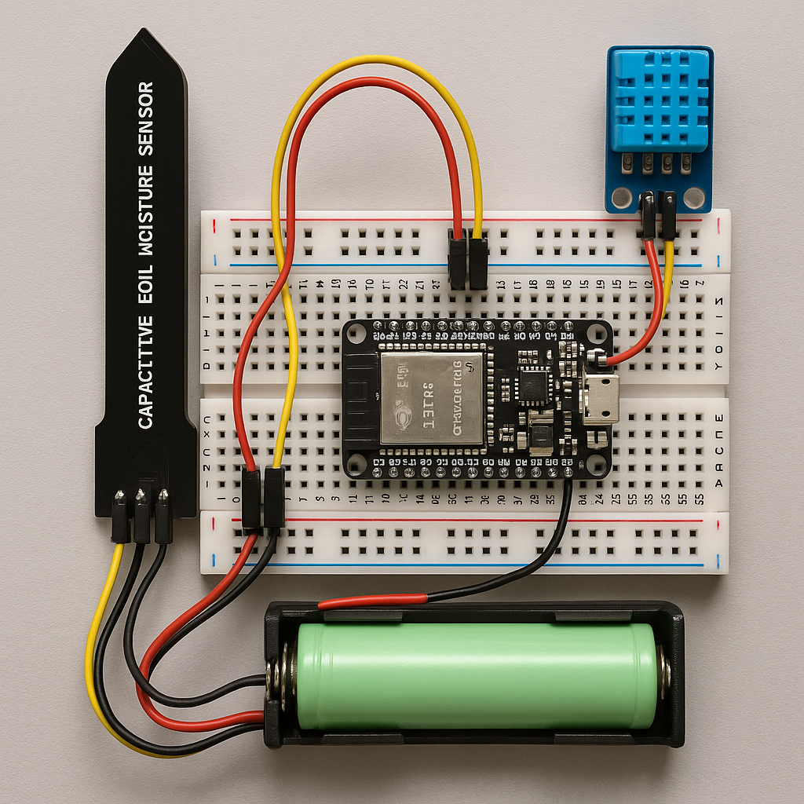
Implementation

Slide 13
Conclusions
Connecting IoT components to the Blynk app enables remote monitoring and control through a simple interface, enhancing automation and real-time data access.
The hardware setup, including Arduino Espressif 32 and sensors, ensures precise data collection.
The CNN model supports accurate disease detection, improving plant health monitoring.
Future enhancements could include additional sensors, rainwater harvesting systems, and advanced AI models for better scalability and sustainability.

